Slide 1
CRESEL at Blatchley Middle School
What does it all mean?

Slide 2
Learning targets
I can identify key components of CRESEL
I can explain how CRESEL is an integral part of MTSS
I can define my “why” in this work
I can demonstrate both being a leader and a team player in achieving group goals

Slide 3
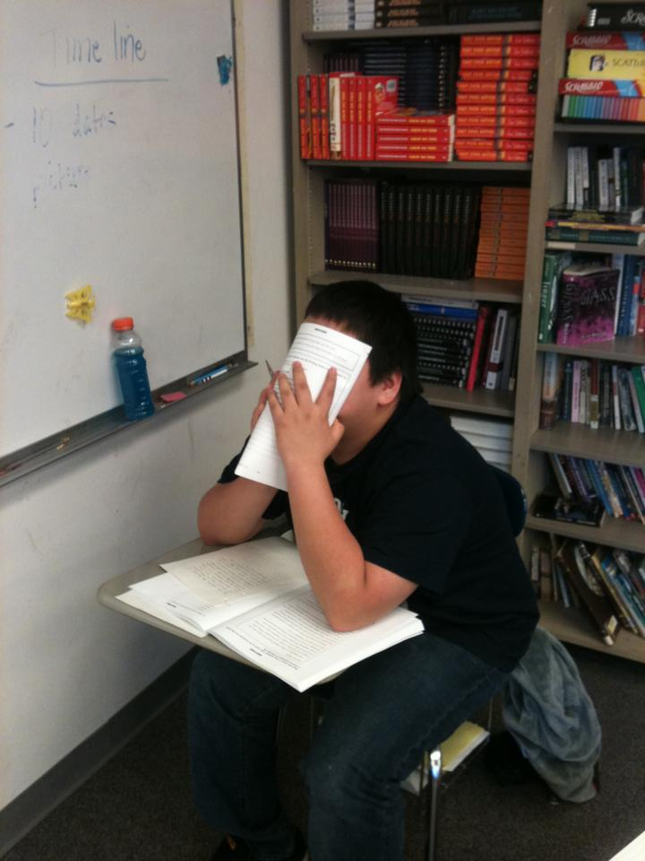
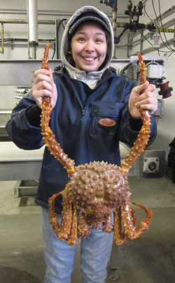
Why we continue to do what we do
Donovon
Paulette

Slide 4
What is cresel?
CRESEL stands for Culturally Responsive Embedded Social-Emotional Learning
SSD Vision: Culturally Responsive Process Embedded in the Fiber of our Schools to Support Students, Families, and Educators by Utilizing Community Partnerships, Professional Development Opportunities, and Deliberate School-based Practices, Including:
Recognizing and Managing Emotions
Respecting and Having Empathy for Others
Making Constructive and Ethical Choices

Slide 5
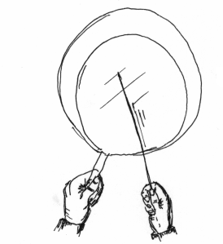
BUILD UNDERSTANDING
Building shared understanding of how trauma impacts learning
Shared understanding of trauma and the biology of toxic stress
Adult co-regulation skills
Strategies for building learning brains
School-wide resilience centered practices
RESPECT
Creating a supportive school climate and environment
Physical, emotional, cultural, and academic safety
Culturally responsive teaching and learning
environment
School-wide positive behavior supports (e.g
restorative practices, PBIS)
Youth voice and leadership
MODEL
Supporting adults in developing and using
their own SEL skills to foster relationships
Adult SEL skills and self-regulation
Supportive relationships with students
Strong family-school partnerships
Collegial and supportive staff relationships
CO-CREATE
Collaborating through authentic partnerships to integrate culture and transform education systems
Community dialogue and conversation
Partnerships for cultural integration in teaching and learning
Community strength and resilience as the foundation
Regular and ongoing communication loop between school and community
TEACH & PRACTICE
Directly teaching culturally responsive SEL skills with opportunities to practice these skills throughout the school day and after school
Common language to identify and discuss SEL skills
(e.g. SEL learning standards)
Direct SEL skill instruction
Teaching strategies and routines that reinforce SEL skill practice in academics
School day SEL reinforced during afterschool
time (in sports, activities, at home)
SUPPORT
Aligning and integrating culturally responsive SEL into district and school infrastructure
Shared vision, goals, action plan
Policies and practices (e.g. RTI/ MTSS,
teaching framework)
Ongoing job embedded professional
learning
Regular examination of data and progress
towards goals
Culturally Responsive Embedded Social & Emotional Learning (CRESEL)
Working Draft August 2018

Slide 6
The danger of a single story
Watch a clip from Chimamanda Adichie’s “The Danger of a Single Story”
How can you tie Adichie’s message to the goals of CRESEL and our Tier 1 practices?

Slide 7
Why should we care?
Conjure to your mind three students who would or have benefitted from this work.
“Consider the Youth” circle activity

Slide 8
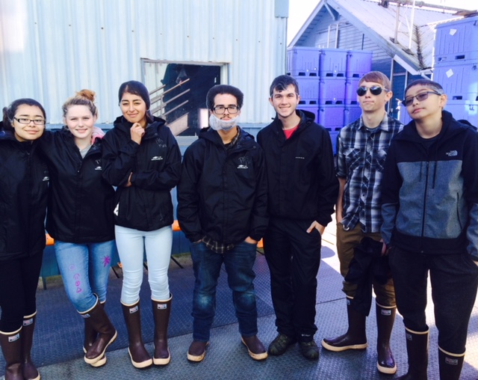

Slide 9
What does it mean for BMS and my classroom?
Four quadrants activity
Changing society
Characteristics of the community
Nature of the student body
Research on curriculum, teaching, and learning
Discuss in your group: As educators, why is it important that we review this information collectively?

Slide 10
Collectively creating a vision
In your group, answer the following question
What features should make the curriculum and climate at Blatchley Middle School unique?
Identify three adjectives per group
For each adjective, jot down a sentence or two that explains or expands on the adjective

Slide 11
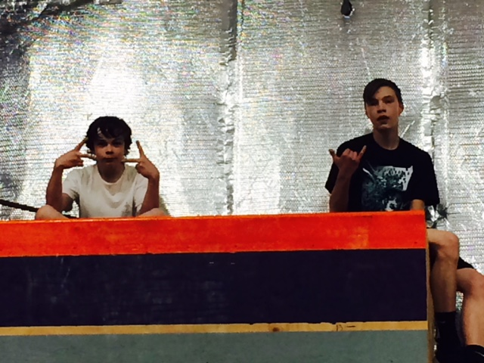
Closing
What is one thing that you can take from this time together and apply to your practice?

