Slide 1
KIBSD + CRESEL
Champions PLC
Dec. 3rd, 2018

Slide 2
Current Status
Profile of a KIBSD Learner
Professional Development and Inservice
Resource Implementa-tion & Advisories
CRESEL Phase I

Slide 3
CRESEL Phase I - II
Community Meetings
(2 elem/RS)
Curricular Resources Purchased (Elem & HS)
Caring Schools & Morning Meetings in all Elementary classrooms
Advisories in MS/HS

Slide 4
Profile
(Be Like and Think Like)
Academics (Know/Do)
Cultural Proficiencies
Social Emotional Learning

Slide 5
Profile – What do we want our learners to Be Like and Think Like
Stakeholders Defined
Graphic with Competencies
Learning Progressions with strategies and resources

Slide 6
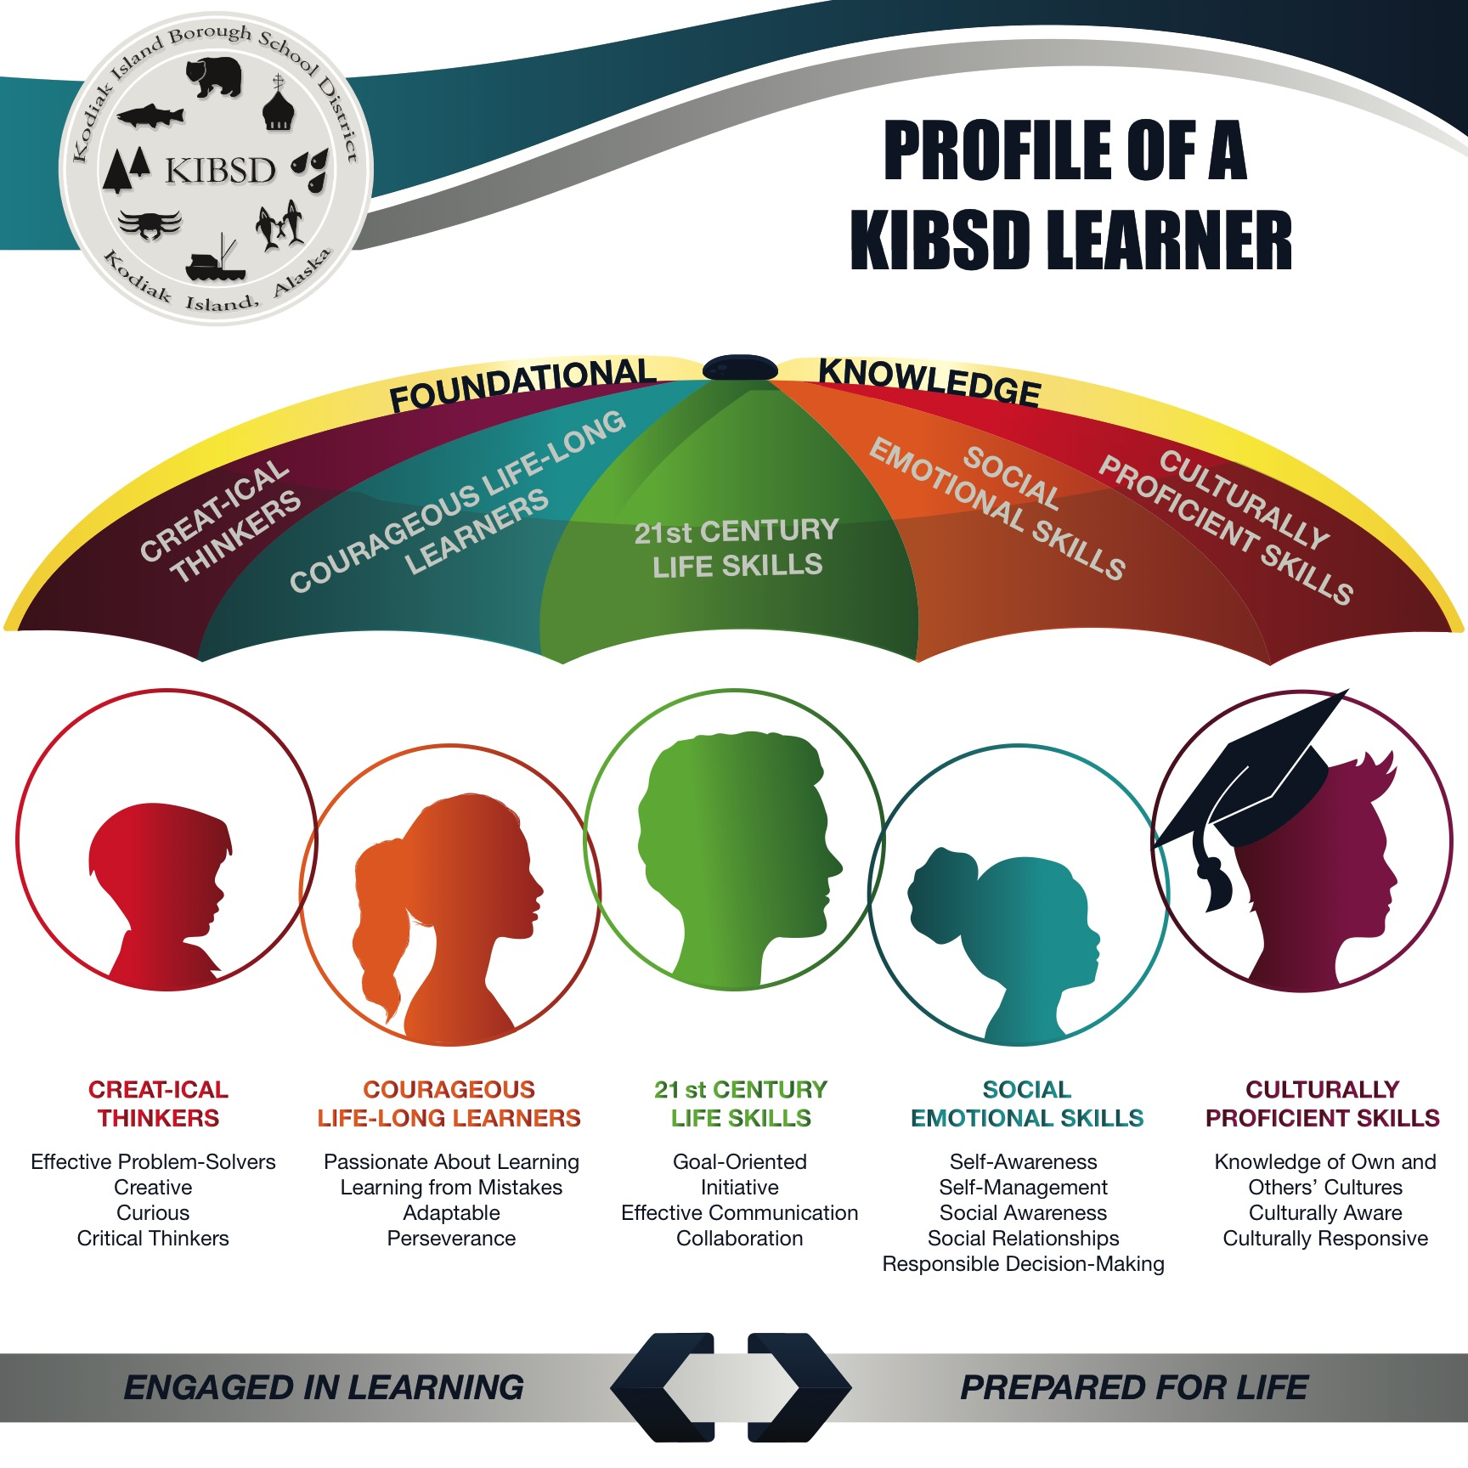

Slide 7
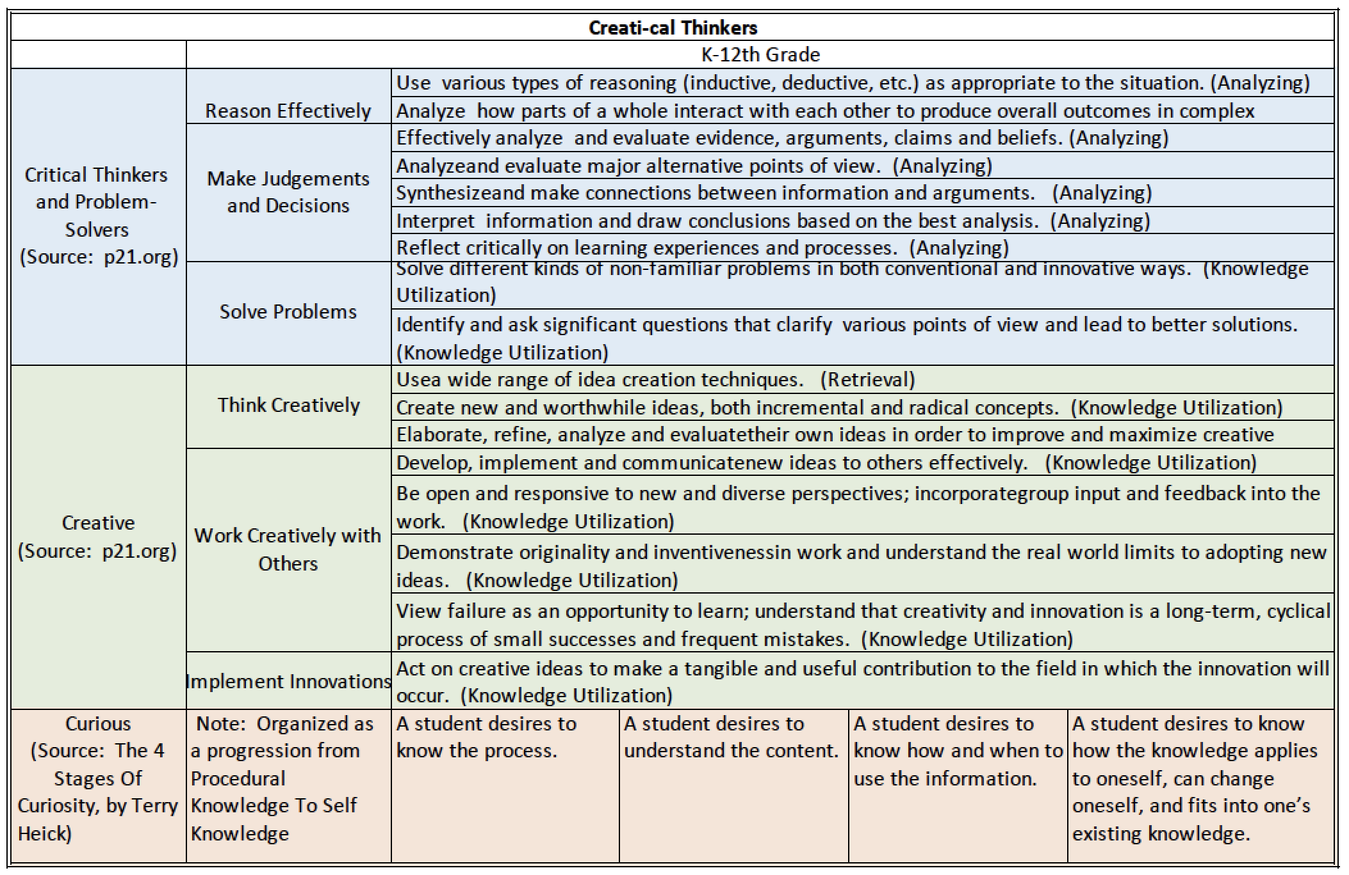

Slide 8
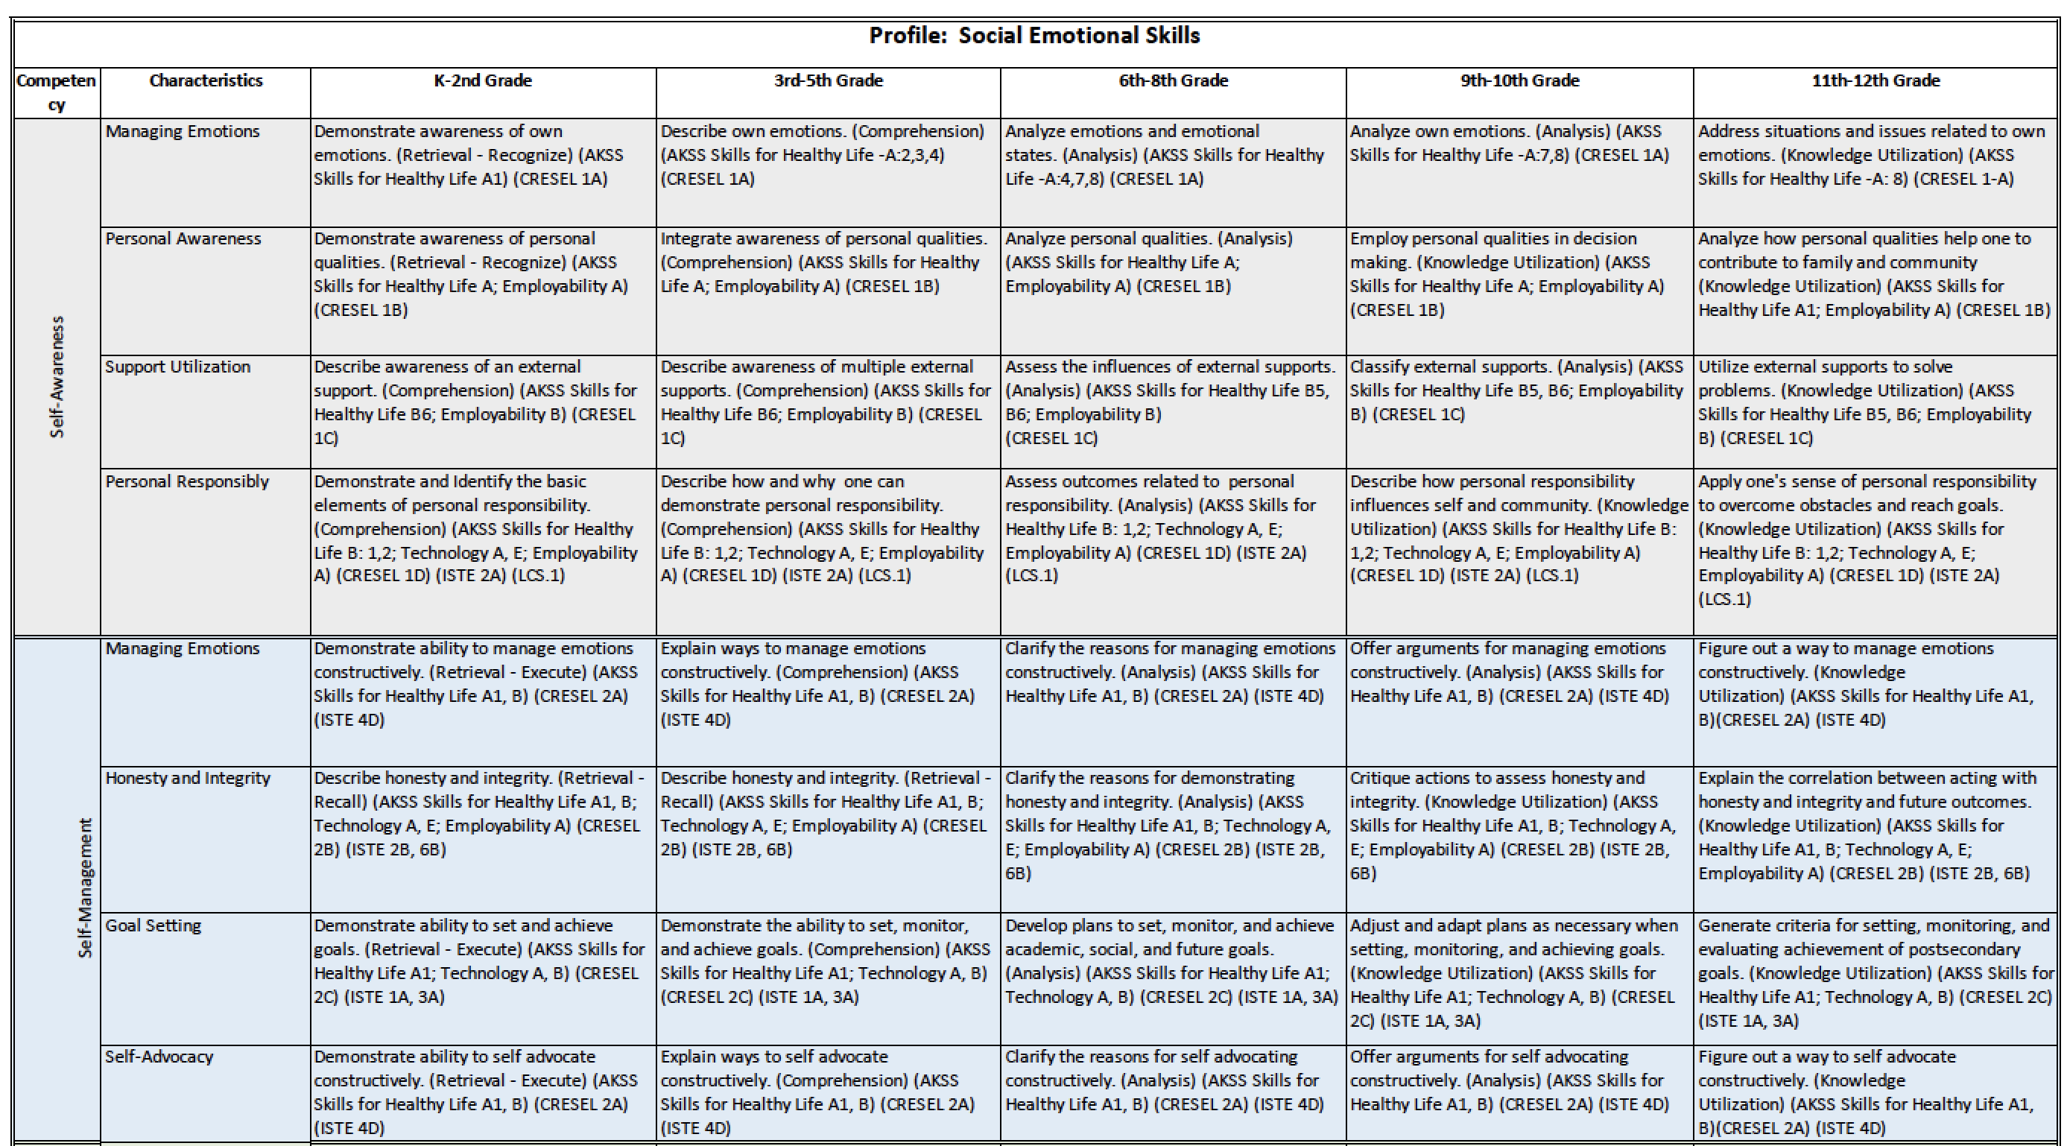

Slide 9
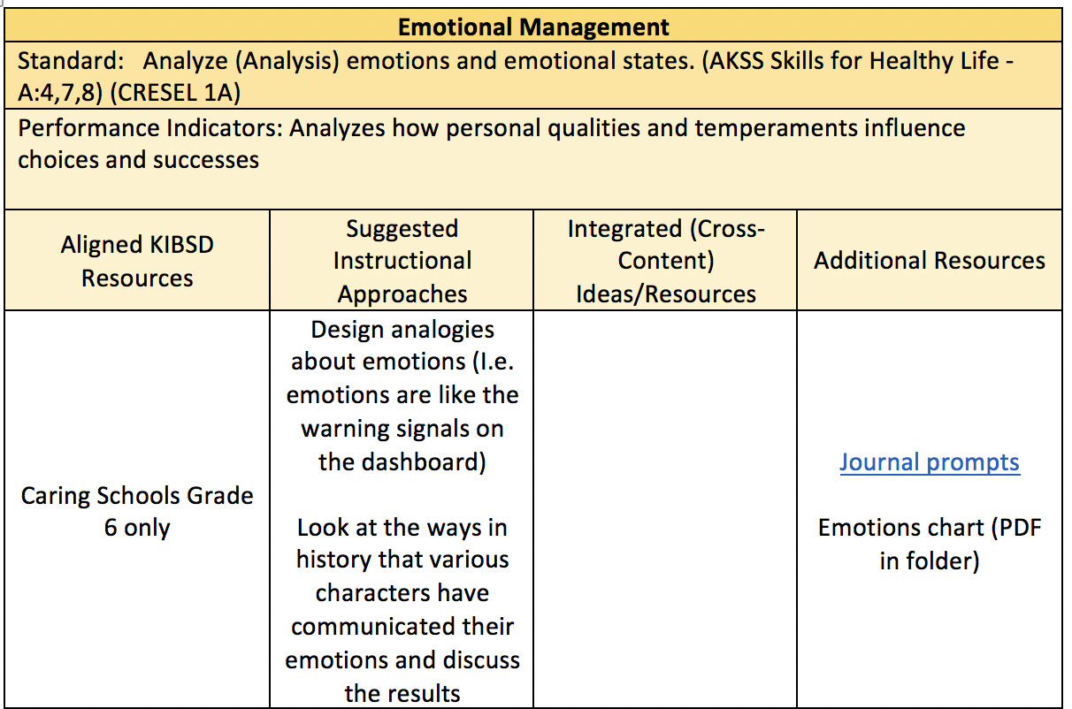

Slide 10
2018-2019 District-Wide Focus: Social Emotional Well-Being (including safety) and Effective Instruction
Profile of a KIBSD Learner Goal:
All profiles at awareness level
Social Emotional Skills (SES) Profile implementation level
SES competencies and descriptors are common language amongst all stakeholders
Specific SES approaches/strategies are identified, implemented and celebrated
Teacher focus conferences include elements associated with Conditions for Learning as growth goals

Slide 11
The Plan
Professional Development
Tracks: Meeting the Needs of All Learners
Workshops: strategies/resources updated
Inservices and Outside Support – Training
Community Partnership and Public Relations Marketing

Slide 12
How are we doing?
Professional Development Impact
Tracks –
increased awareness
Some change in practices
Unknown REAL impact
Workshops – not yet

Slide 13
Inservices/Trainings
AASB – Aug. DWIS
Full-time counselors in all buildings
Caring Schools online training
KANA specialists
Possible: LifeSpace or Learning and the Brain onsite workshops; community meetings with AASB

Slide 14
Community Partnerships
Maybe begin work in Jan

Slide 15
Profile of a KIBSD Learner Goal:
All profiles at awareness level
Social Emotional Skills (SES) Profile implementation level
SES competencies and descriptors are common language amongst all stakeholders
Specific SES approaches/strategies are identified, implemented and celebrated
Teacher focus conferences include elements associated with Conditions for Learning as growth goals (Elementary Middle School High School)

Slide 16
Celebrations
Awareness
Elementary morning meetings and impact
HS nudge through advisory
MS embedded attempts
Resources
Profile

Slide 17
Challenges
How can we influence system change when not in a position of authority?
preceding question: Is implementation of tools and projects the change we intend to achieve or is it bigger than that?
Tag-along question: How does a system, or even a classroom, maintain a focus and commitment to plans for long-term changes in the midst of reacting to the day-to-day issues that demand action? What is our role in relationship with this?
What was our “why” from the beginning? What can we measure (or what are you measuring)?
What could AASB do to help admin hear that this is a crucial part of the process?

