Slide 1
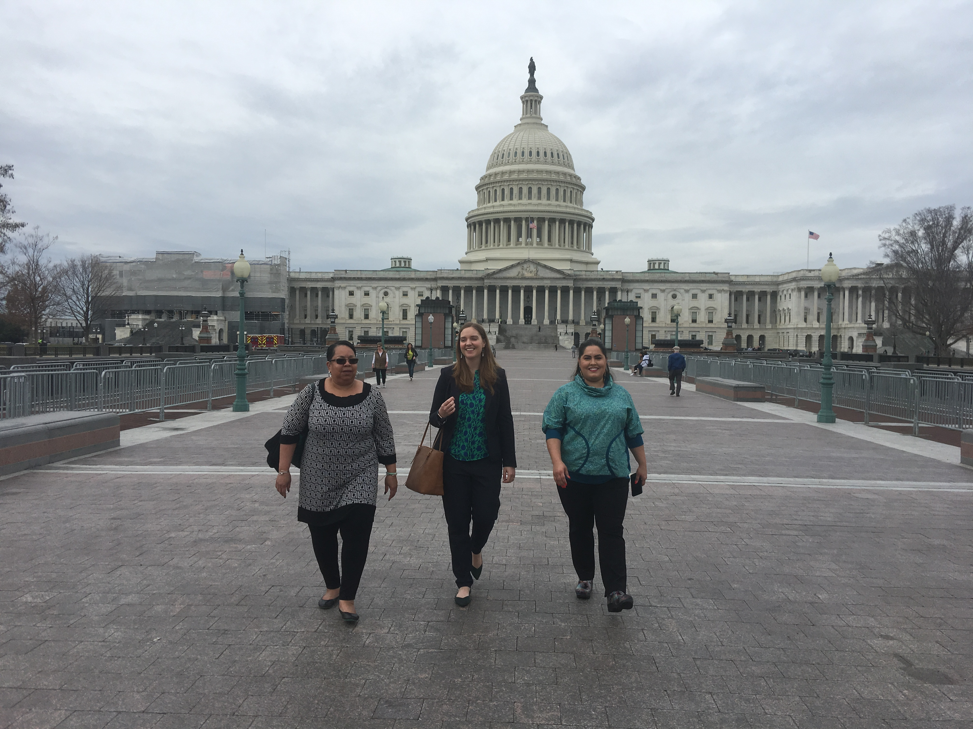
2020 NSBA
Advocacy Institute

Slide 2
AASB Representatives
President Michael Swain (Bristol Bay)
President Elect Katie Oliver (Kodiak)
Past President/NSBA BOD Tiffany Jackson (Sand Point)
NSBA BOD Elect Pete Hoepfner (Cordova)
Margo Bellamy (Anchorage Board Member)

Slide 3
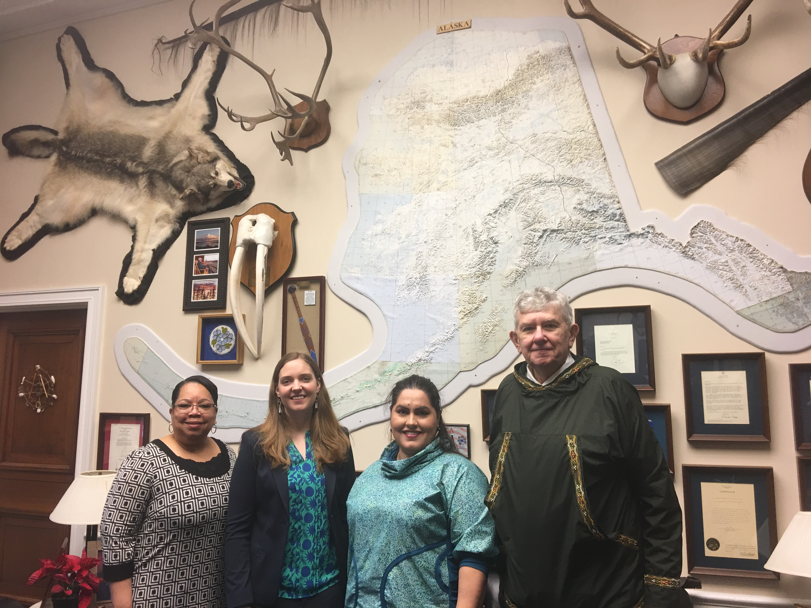
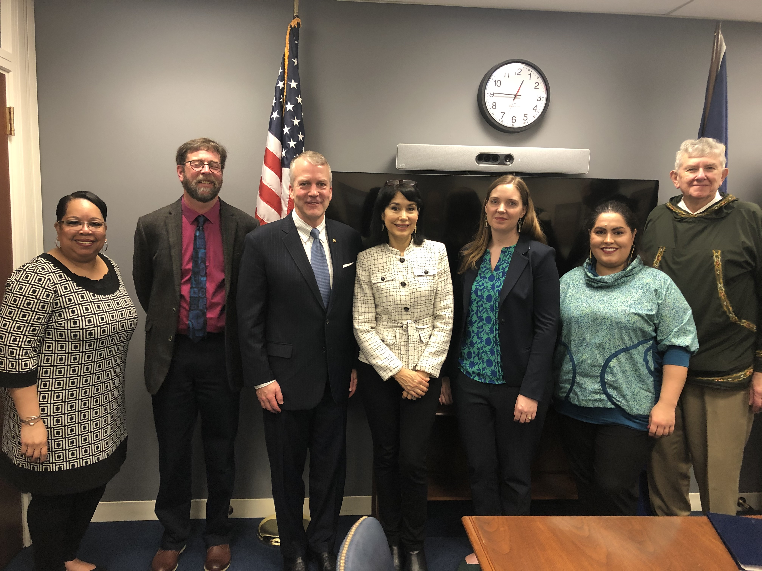
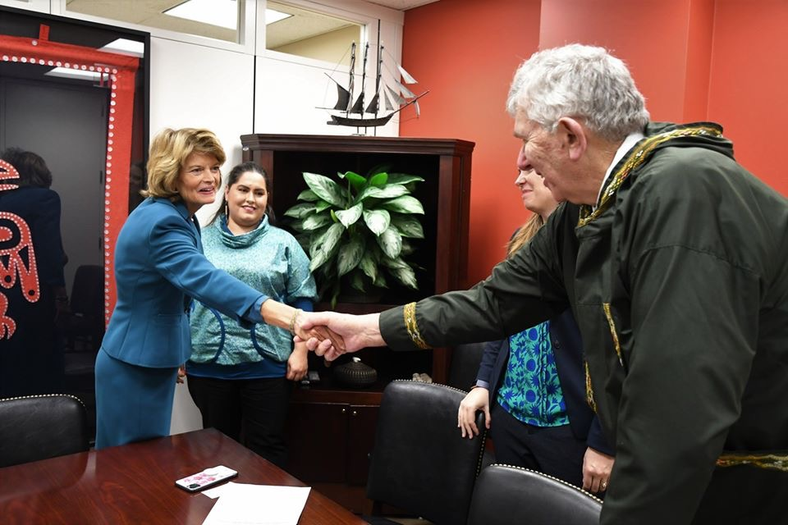
Capitol Hill Appointments
Senator Dan Sullivan
Senator Lisa Murlowski
Congressman Don Young (Deputy Chief of Staff Alex Ortiz)

Slide 4
AASB’s Talking Points
Broadband Capacity
Lack of capacity in Rural & Urban Alaska
Proposed FCC rule to place subcap on ERate and Rural Healthcare programs
Bills in Alaska Legislature to raise state goal – 10Mbps➔25 Mbps
Waiver from USDOE to prevent increased Erate funding from affecting Federal Disparity Test.

Slide 5
AASB’s Talking Points
Recruitment & Retention of Teachers
“Shallow” pool of teachers applying for jobs
Unfilled teaching positions across the state
Reauthorization of Higher Education Act(HEA)
Increase funding for Title II (Professional Development & Recruitment
Preparing & Retaining Education Professionals (PREP Act) Senator Tim Kaine (D-Virginia)

Slide 6
AASB’s Talking Points
IDEA Funding
IDEA is 45 years old – commitment was to fund up to 40%
Currently funded by federal gov’t at 14% - 17%.
Alaska districts are 13%-20% of their budgets on special education
Congress needs to implement a “glide path” to increase funding annually to achieve the 40% threshold

Slide 7
AASB’s Talking Points
Diversion of Public Funds to Private Schools
90% of America’s children attend public school
Alaska has multiple options within the public school system – charters, residential, home school, correspondence, distance delivery, CTE, middle college, advanced placement, etc.
Public Funds for Public Schools! (Vouchers, Tax Credits, Alternative Scholarships, Education Freedom Scholarships, For-Profit Charters, etc.

Slide 8
